Slide 1

Presentation Materials Created by Mimetics Inc.
Free use by anyone for non-commercial purposes
Copyrights, Trademarks and other Registered Marks the Property of their Owners

Slide 2
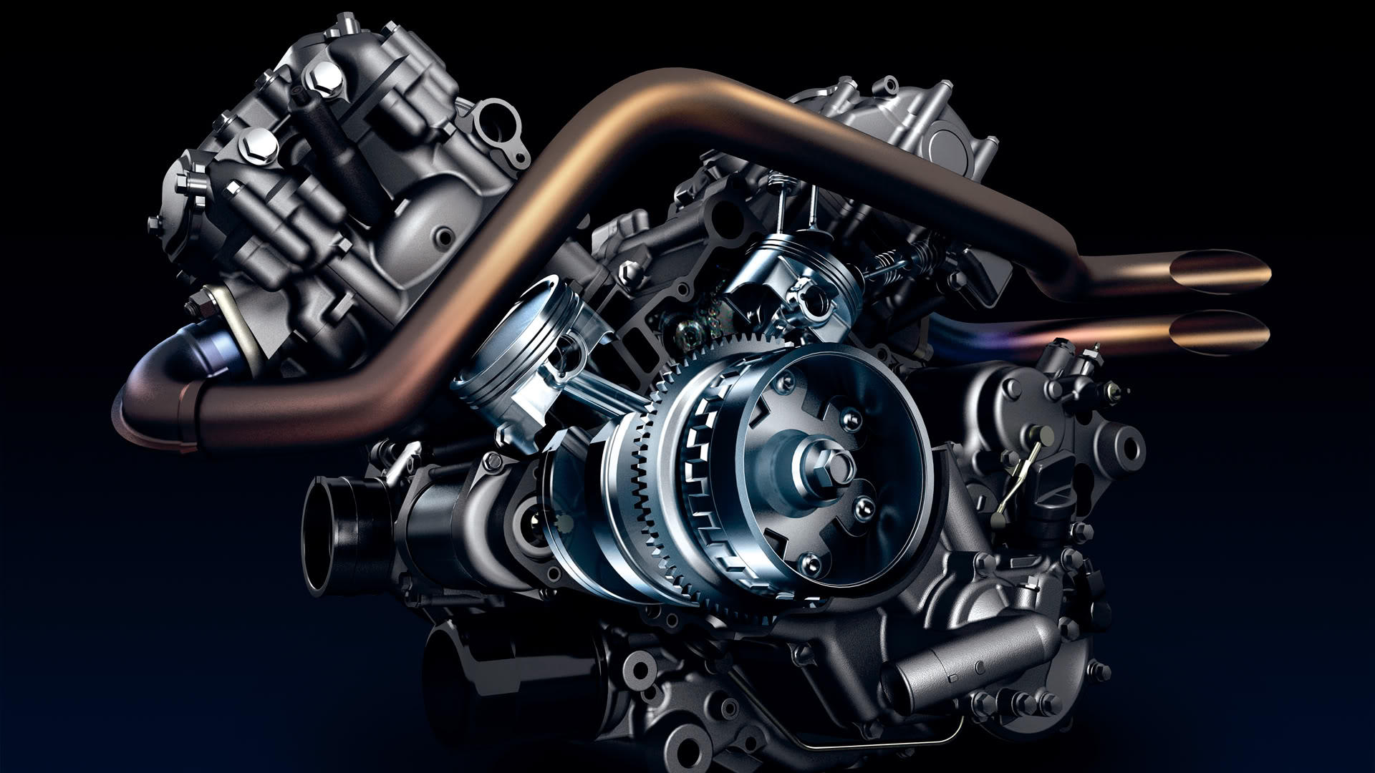
Grade 8 Systems - Class 3
Math & Sensors Log In
Notes:
We want to introduce the Jade Robot and it’s Tools in more detail along with our action plans for it.
It’s interesting, but it’s easy to criticize something when it’s done (especially when you have experience) – a *LOT* more difficult getting it right from the start. Also, preparing this presentation was a great way to review and think about what we should be doing.

Slide 3
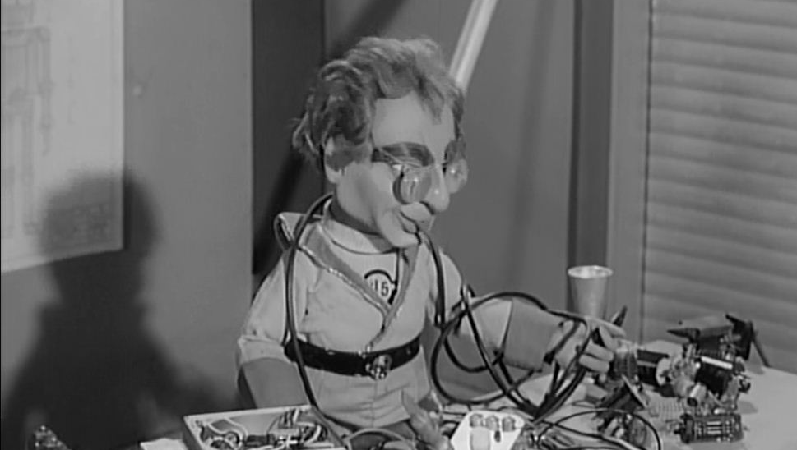
Rule One
Robots Run on the Floor
NO BROKEN ROBOTS!
Notes:
Can Demo Jade Scratch if people are interested. In doing this product I’ve had a few interesting discoveries – one was going with a simpler programming language actually has a *LOT* of value for an expert like myself.

Slide 4
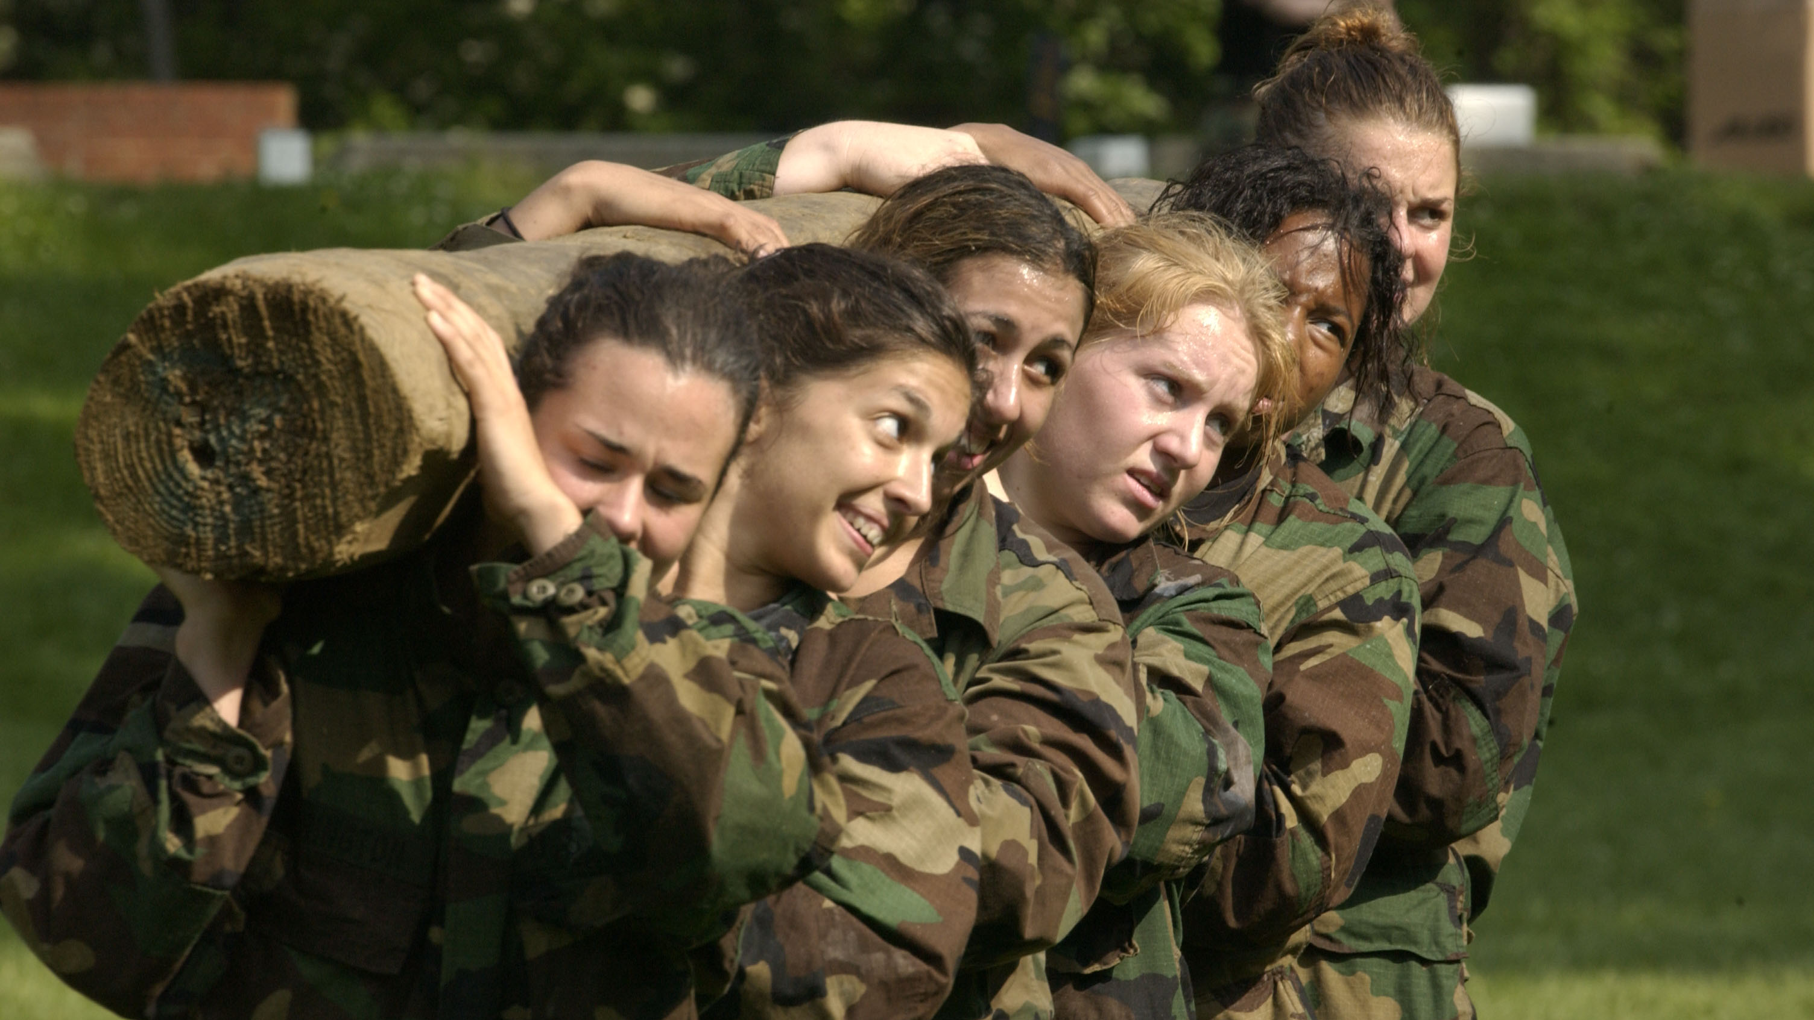
Rule Two
We ALL Stay Together
Don’t Go Ahead Until Told
If You Have a Problem, LET ME KNOW!
Notes:
Can Demo Jade Scratch if people are interested. In doing this product I’ve had a few interesting discoveries – one was going with a simpler programming language actually has a *LOT* of value for an expert like myself.

Slide 5
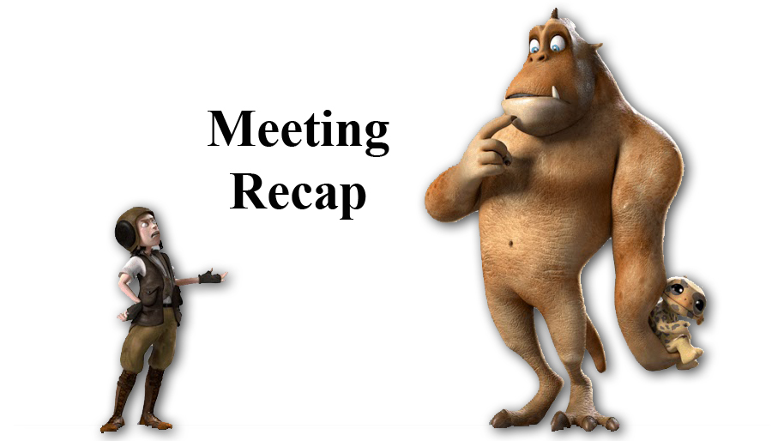
Recap
What is Programming?
How many milli-seconds are in 1 second?
What is “Cloning”?
What is a Loop?
What are the Outputs on the Jade Robot?
Notes:
Can Demo Jade Scratch if people are interested. In doing this product I’ve had a few interesting discoveries – one was going with a simpler programming language actually has a *LOT* of value for an expert like myself.

Slide 6
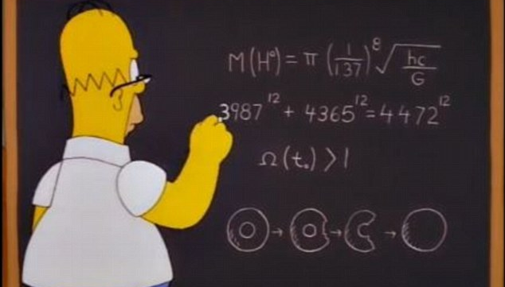
Mathematical Operations
Notes:
We clone a community project into “My Projects” so we can make changes to it without affecting all the “Community Projects”

Slide 7
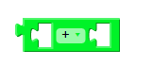
Mathematical Operations
= (1st Op 2nd)
1st
2nd
Notes:
Can Demo Jade Scratch if people are interested. In doing this product I’ve had a few interesting discoveries – one was going with a simpler programming language actually has a *LOT* of value for an expert like myself.

Slide 8
Mathematical Operators
= (1st Op 2nd)
1st
2nd
+ ⬅ Addition 1st + 2nd
- ⬅ Subtraction 1st – 2nd
* ⬅ Multiplication 1st x 2nd
/ ⬅ Returns Dividend of 1st / 2nd
% ⬅ Returns Remainder or “Modulo” of 1st / 2nd
Where do Operator Symbols Come From?
Notes:
Can Demo Jade Scratch if people are interested. In doing this product I’ve had a few interesting discoveries – one was going with a simpler programming language actually has a *LOT* of value for an expert like myself.

Slide 9

*
Is Known
As “Splat”
Notes:
Can Demo Jade Scratch if people are interested. In doing this product I’ve had a few interesting discoveries – one was going with a simpler programming language actually has a *LOT* of value for an expert like myself.

Slide 10
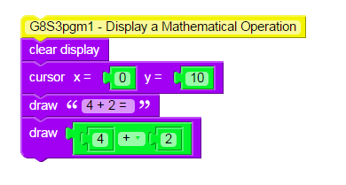
Clone and Change Values
Notes:
Can Demo Jade Scratch if people are interested. In doing this product I’ve had a few interesting discoveries – one was going with a simpler programming language actually has a *LOT* of value for an expert like myself.

Slide 11
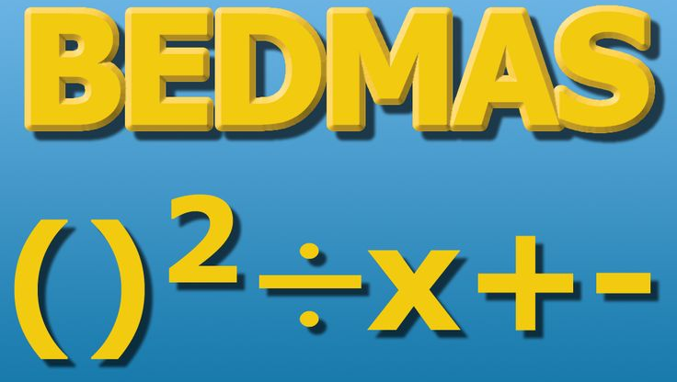
Notes:
Can Demo Jade Scratch if people are interested. In doing this product I’ve had a few interesting discoveries – one was going with a simpler programming language actually has a *LOT* of value for an expert like myself.

Slide 12
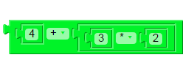
What is order of Operations for:
= (4 + (3 * 2))
Notes:
Can Demo Jade Scratch if people are interested. In doing this product I’ve had a few interesting discoveries – one was going with a simpler programming language actually has a *LOT* of value for an expert like myself.

Slide 13
= (4 + (3 * 2))
BEDMAS IS NOT RELEVANT IN SCRATCH!
Notes:
Can Demo Jade Scratch if people are interested. In doing this product I’ve had a few interesting discoveries – one was going with a simpler programming language actually has a *LOT* of value for an expert like myself.

Slide 14
= (4 + (3 * 2))
BEDMAS IS NOT RELEVANT IN SCRATCH!
(or Any Other Programming Statements with Brackets)
Notes:
Can Demo Jade Scratch if people are interested. In doing this product I’ve had a few interesting discoveries – one was going with a simpler programming language actually has a *LOT* of value for an expert like myself.

Slide 15
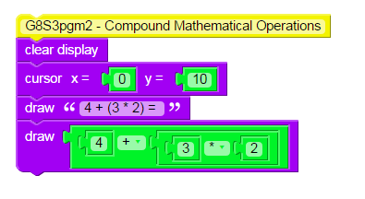
Clone and Change Values
Notes:
Can Demo Jade Scratch if people are interested. In doing this product I’ve had a few interesting discoveries – one was going with a simpler programming language actually has a *LOT* of value for an expert like myself.

Slide 16
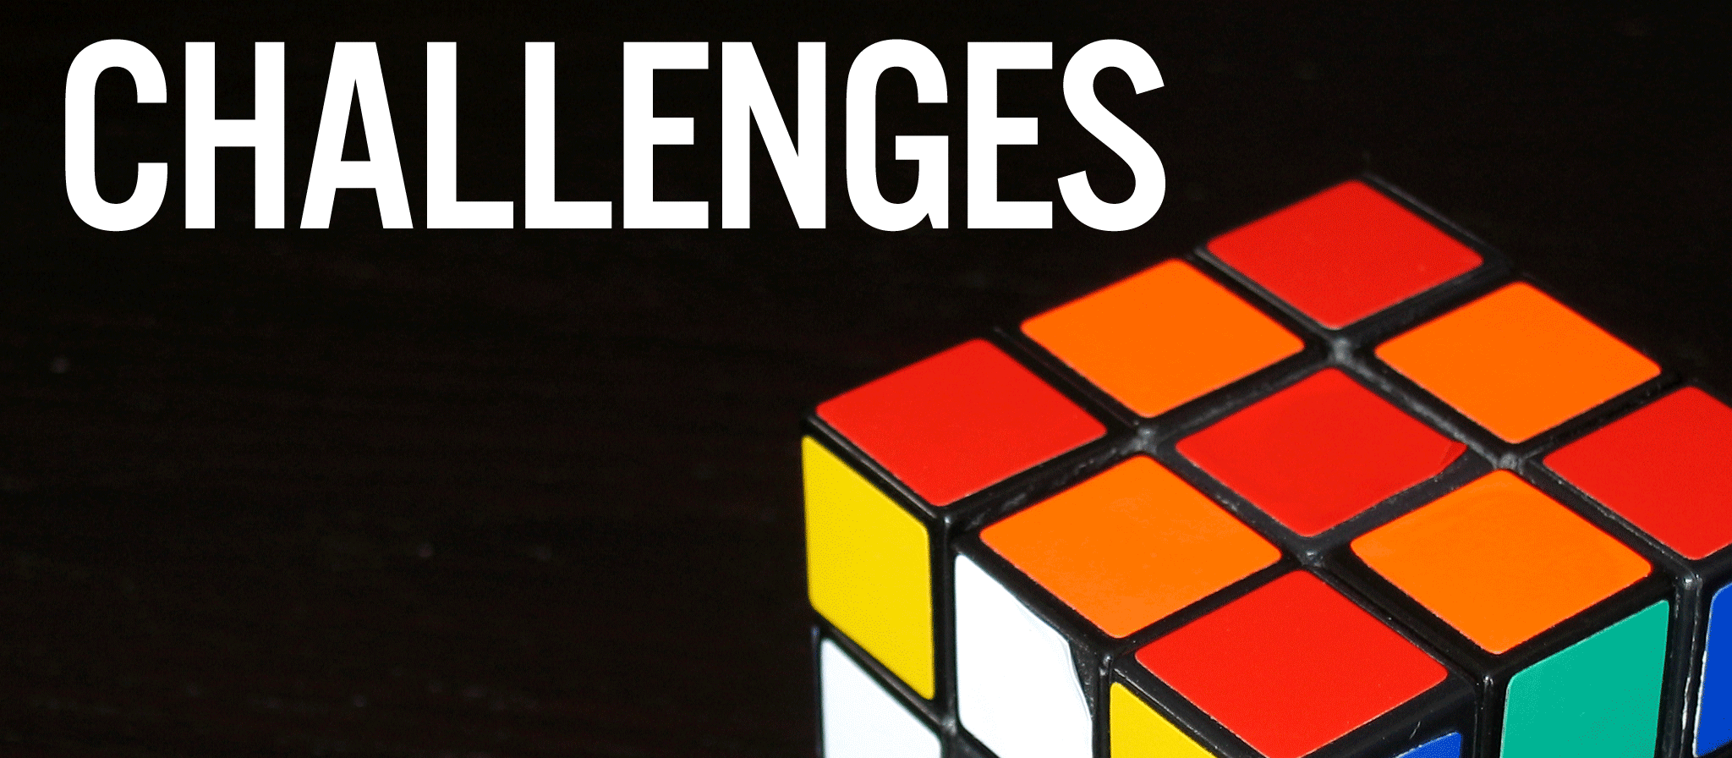
Who can Make the Largest Number Using
+, -, *, /, %?
Notes:
Can Demo Jade Scratch if people are interested. In doing this product I’ve had a few interesting discoveries – one was going with a simpler programming language actually has a *LOT* of value for an expert like myself.

Slide 17
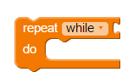
Repeat “while”/”until” Loop
Repeat WHILE Value is Not Zero
Repeat UNTIL Value is Not Zero
⬅ WHILE/UNTIL Value
Statements inside
Loop
Notes:
Can Demo Jade Scratch if people are interested. In doing this product I’ve had a few interesting discoveries – one was going with a simpler programming language actually has a *LOT* of value for an expert like myself.

Slide 18
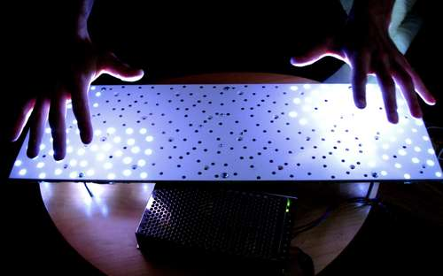
Sensors

Slide 19
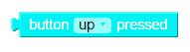
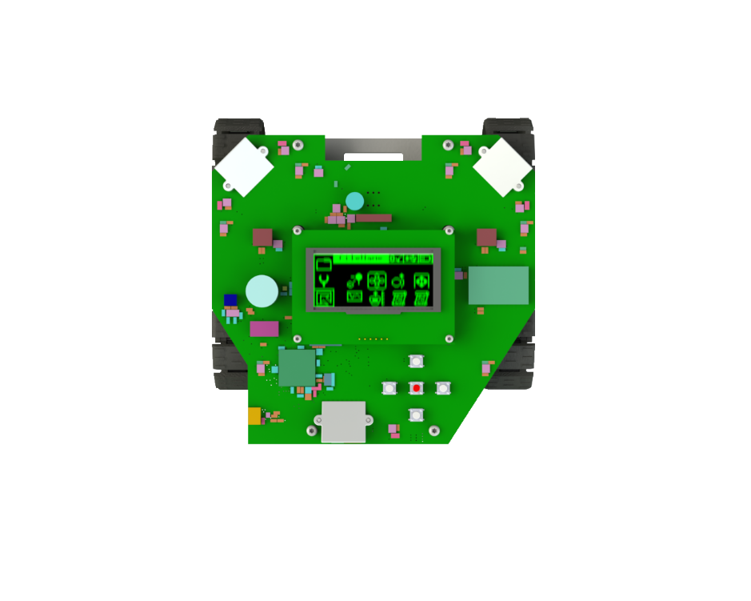
5 Buttons
Return Values:
0 – Not Pressed
Not 0 – Pressed
Top
Left
Right
Bottom
Red Button is “Enter”
Notes:
Can Demo Jade Scratch if people are interested. In doing this product I’ve had a few interesting discoveries – one was going with a simpler programming language actually has a *LOT* of value for an expert like myself.

Slide 20
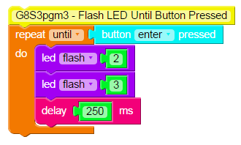
Clone and Change Buttons
Notes:
Can Demo Jade Scratch if people are interested. In doing this product I’ve had a few interesting discoveries – one was going with a simpler programming language actually has a *LOT* of value for an expert like myself.

Slide 21
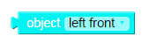
5 Object Sensors
Return Values:
100 – Far Away
In Between/Distance
0 – Very Close
Left Front
Right Front
Left Side
Right Side
Rear
Notes:
Can Demo Jade Scratch if people are interested. In doing this product I’ve had a few interesting discoveries – one was going with a simpler programming language actually has a *LOT* of value for an expert like myself.

Slide 22
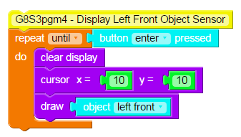
Clone and Change Object Sensors
Notes:
Can Demo Jade Scratch if people are interested. In doing this product I’ve had a few interesting discoveries – one was going with a simpler programming language actually has a *LOT* of value for an expert like myself.

Slide 23

3 Light Sensors
Return Values:
100 – Very Bright
In Between/Distance
0 – Very Dark
Right
Left
Rear
Notes:
Can Demo Jade Scratch if people are interested. In doing this product I’ve had a few interesting discoveries – one was going with a simpler programming language actually has a *LOT* of value for an expert like myself.

Slide 24

Clone and Change Light Sensors
Notes:
Can Demo Jade Scratch if people are interested. In doing this product I’ve had a few interesting discoveries – one was going with a simpler programming language actually has a *LOT* of value for an expert like myself.

Slide 25
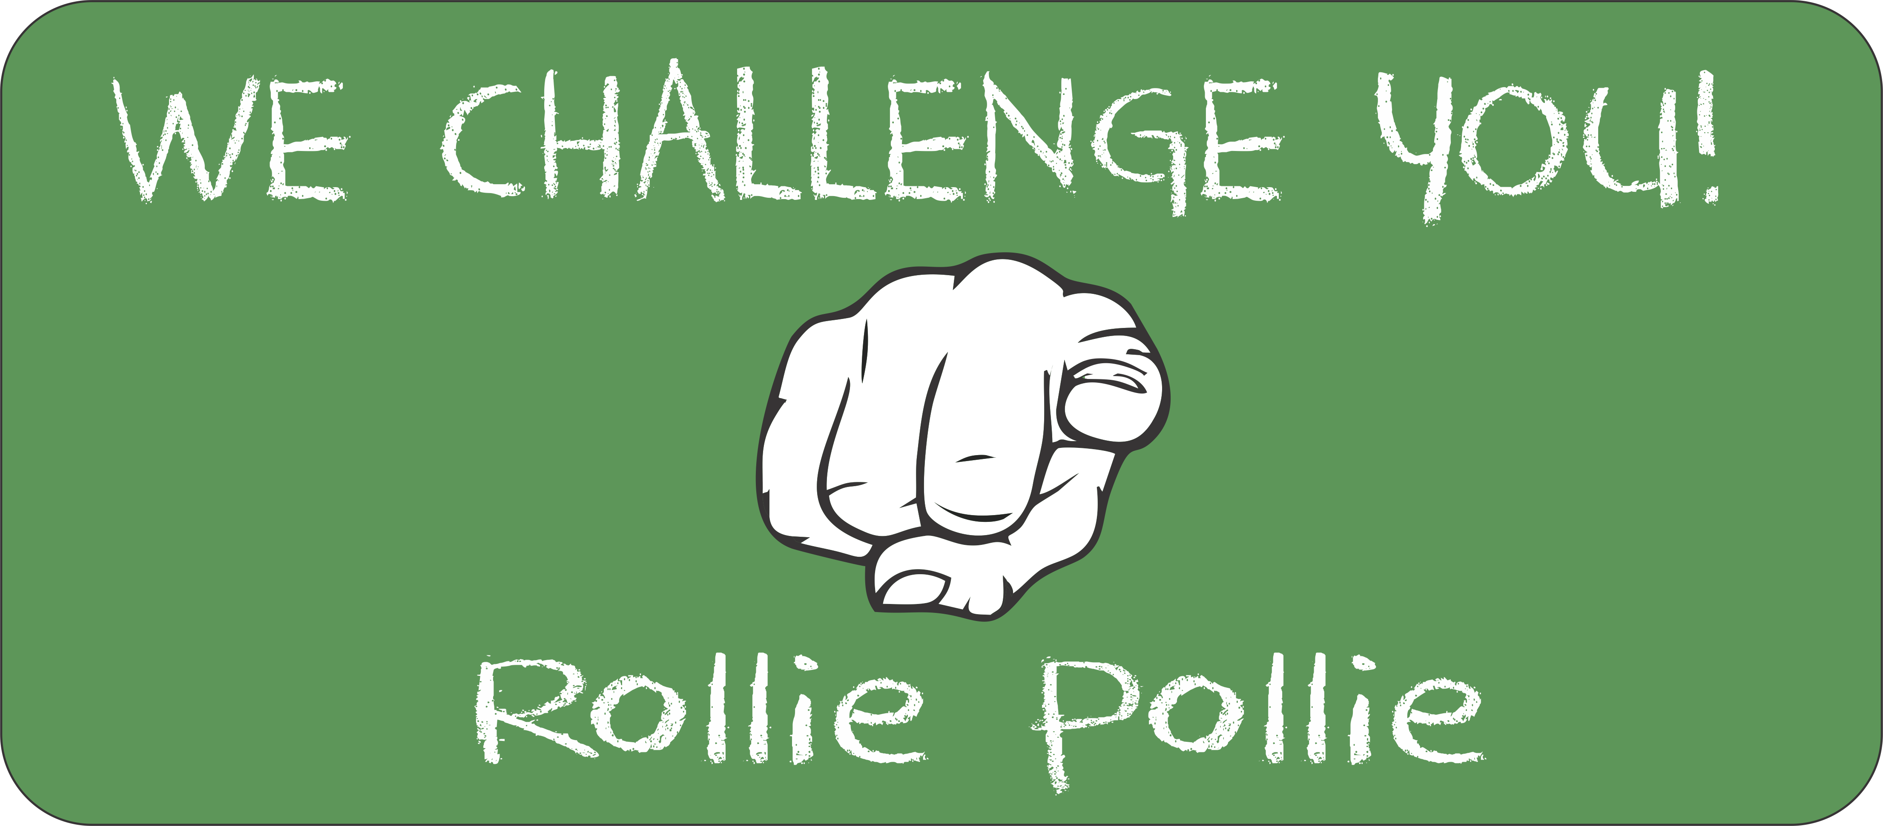

Pick Object or Light Sensors and Display 2 or More Values Simultaneously
Notes:
Can Demo Jade Scratch if people are interested. In doing this product I’ve had a few interesting discoveries – one was going with a simpler programming language actually has a *LOT* of value for an expert like myself.

Slide 26
Stop Here
Notes:
Can Demo Jade Scratch if people are interested. In doing this product I’ve had a few interesting discoveries – one was going with a simpler programming language actually has a *LOT* of value for an expert like myself.

Slide 27
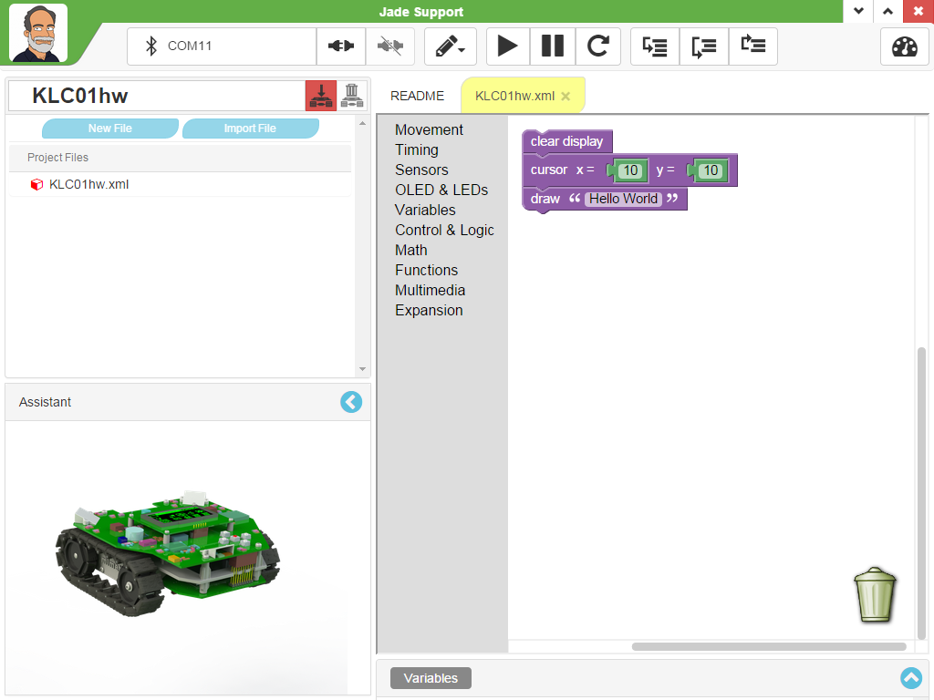
Jade Support
What do these buttons do?
What does this do?
What goes here?
What is this called?
What is this called?
Notes:
Can Demo Jade Scratch if people are interested. In doing this product I’ve had a few interesting discoveries – one was going with a simpler programming language actually has a *LOT* of value for an expert like myself.

